Slide 1






ARTIFICIAL INTELLIGENCE IN AERO SPACE
Arun Udayasuriyan
Dept. of MCA
Faculty of IT & CS
Parul University

Slide 2


INTRODUCTION
Artificial Intelligence (AI) is transforming the aerospace industry by automating complex tasks, optimizing designs, improving safety, and enabling entirely new capabilities such as autonomous flight and predictive maintenance. As aerospace systems become more sophisticated, the integration of AI technologies is becoming essential for maintaining competitiveness, operational efficiency, and innovation.

Slide 3
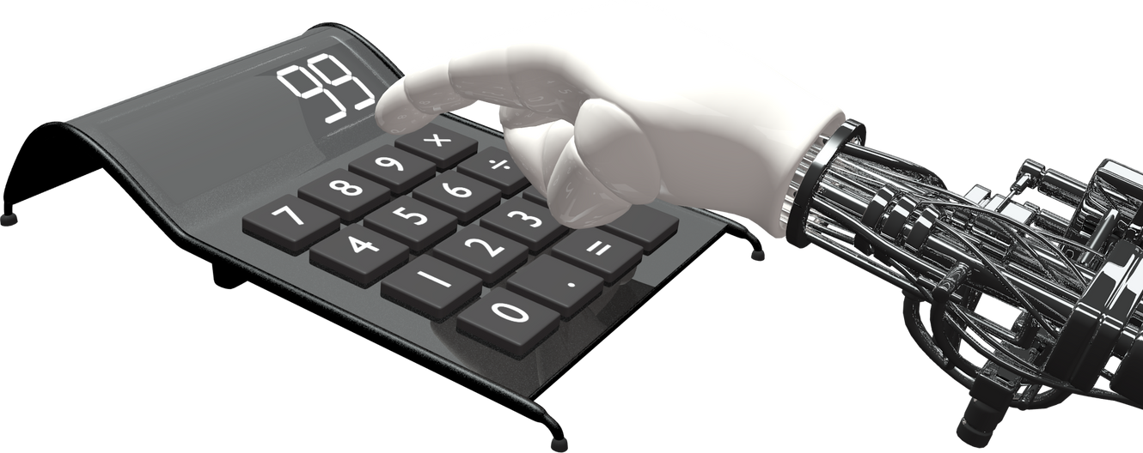
AI
APPLICATION IN AEROSPACE
Artificial Intelligence makes the big impact in the technological world and it involves in the production, manufacturing, biotechnology, Health care and so on. AI is not only booming in the other sectors but but Aerospace engineering sector.

Slide 4
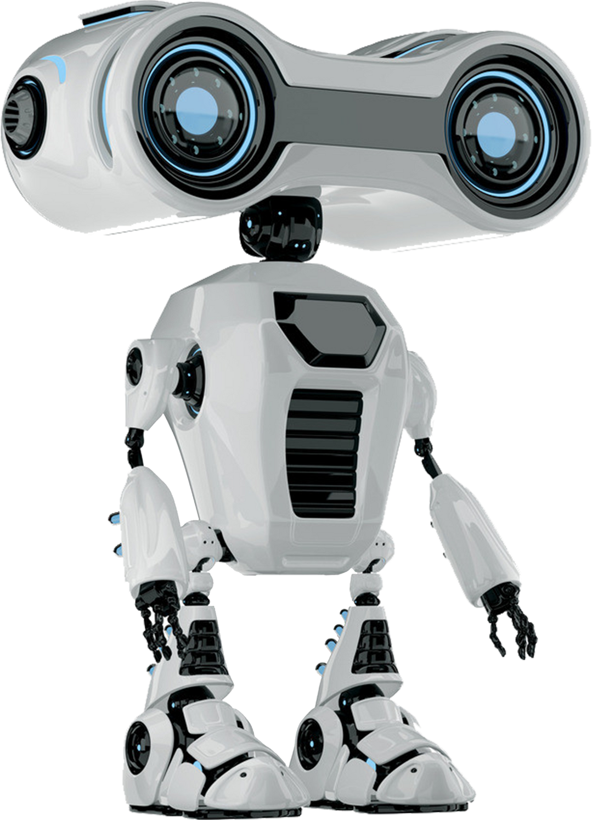
APPLICATIONS
1. Aircraft Design & Manufacturing
2. Autonomous Systems
3. Air Traffic Management
4. Space Exploration
5. Flight Operations & Crew Assistance
6. Safety & Security
7. Customer Experience (Aviation)
8. Research & Development

Slide 5

1. AIRCRAFT DESIGN & MANUFACTURING
Generative Design: AI algorithms optimize aircraft structures for weight, strength, and aerodynamics (e.g., wing shapes, fuselage design).
Predictive Maintenance: Machine learning models analyze sensor data to predict equipment failures before they happen, reducing downtime and cost.
Quality Control: AI-driven visual inspection systems detect defects in parts during manufacturing.

Slide 6
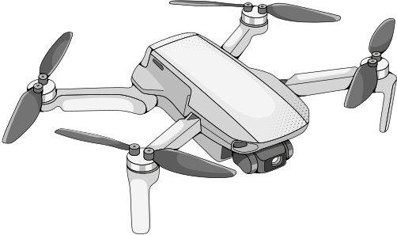
2. AUTONOMOUS SYSTEMS
Drones & UAVs: AI enables autonomous navigation, obstacle avoidance, and mission planning for drones in both defense and civilian applications.
Autonomous Aircraft: Development of pilotless air taxis and cargo aircraft is underway using reinforcement learning and computer vision.
Space Rovers & Satellites: AI aids in autonomous exploration and decision-making for Mars rovers and deep-space probes.

Slide 7
3. AIR TRAFFIC MANAGEMENT
Predictive Analytics: AI models forecast air traffic patterns, optimize routing, and reduce congestion.
Collision Avoidance Systems: AI-based systems enhance situational awareness and automatically suggest evasive maneuvers.

Slide 8
4. SPACE EXPLORATION
Mission Planning: AI helps simulate and plan complex interplanetary missions by analyzing vast variables.
Space Debris Tracking: Machine learning algorithms track space junk to prevent satellite and spacecraft collisions.

Slide 9
5. FLIGHT OPERATIONS &
CREW ASSISTANCE
Virtual Co-Pilots: AI systems assist human pilots with real-time decision-making, especially under stress or emergencies.
Flight Optimization: AI optimizes fuel consumption, route planning, and weather forecasting.

Slide 10
6. SAFETY & SECURITY
Anomaly Detection: AI monitors systems for unusual behavior (cybersecurity, mechanical issues).
Threat Analysis: Machine learning predicts and identifies potential security risks or unauthorized access.

Slide 11
Time to VIDEO
https://youtu.be/3kqSn11HWPg?si=BW3hRini_0CqIDnk

Slide 12
Hands on with AI

Slide 13
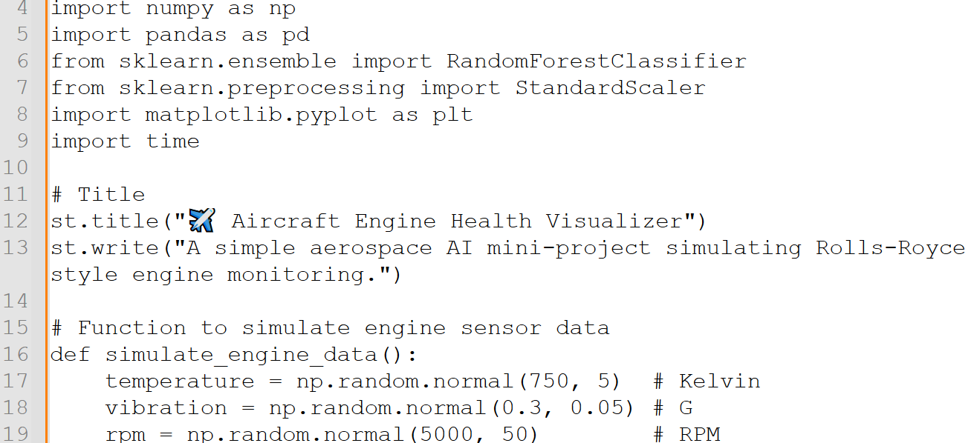

Slide 14
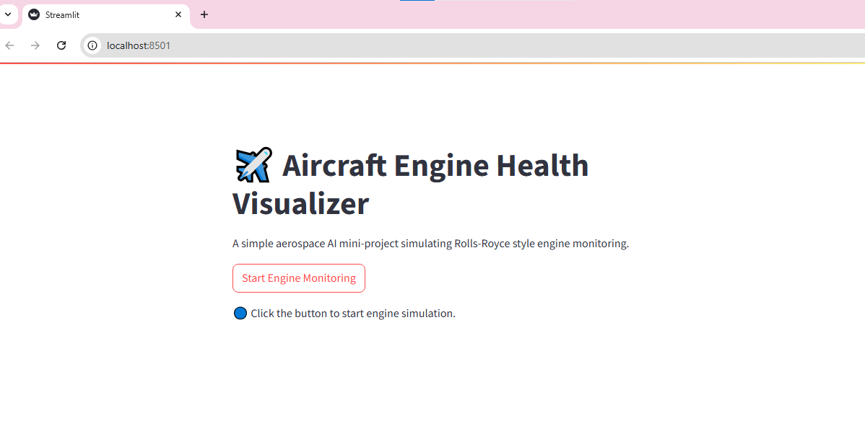

Slide 15
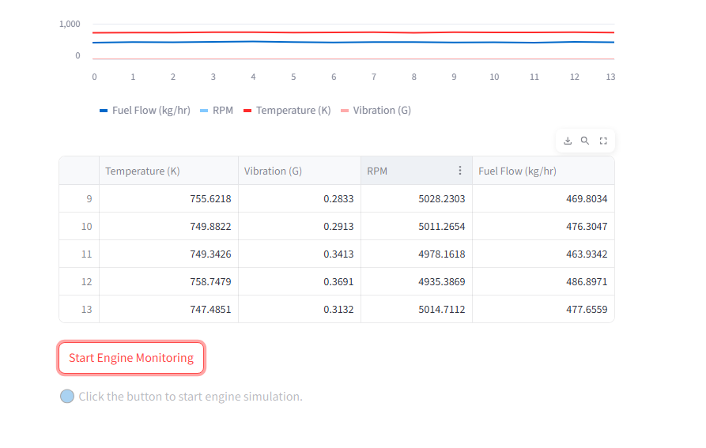

Slide 16
QUESTION AND ANSWER

Slide 17
THANK YOU
WWW.REALLYGREATSITE.COM

